Slide 1
DANCING Protecting the Right to Culture of Persons with Disabilities and Enhancing Cultural Diversity in EU Law
Prof. Delia Ferri
Principal Investigator
This project has received funding from the European Research Council (ERC) under the European Union's Horizon 2020 Research and Innovation programme (grant agreement No. 864182).

Slide 2
Overall Goals
Advance the rights of persons with disabilities
Provide a novel approach to Cultural Diversity in the EU

Slide 3
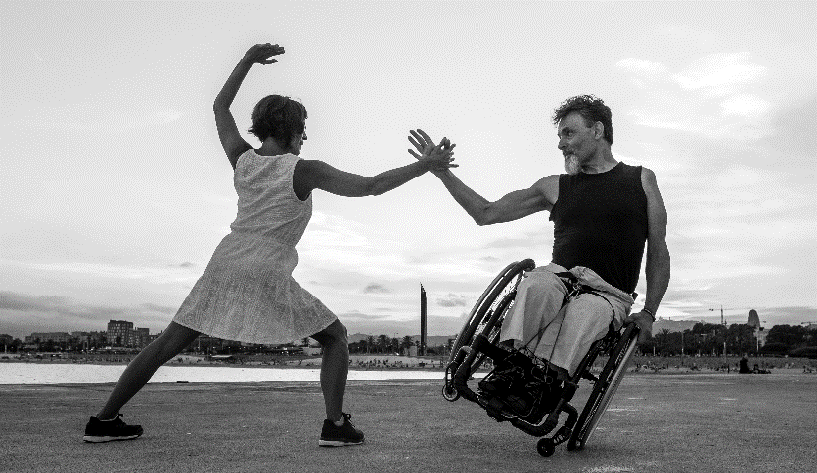
Timeline
September 2020
August 2025

Slide 4
The DANCING Project
WP1
Understanding Barriers and Facilitators
WP 2
Exploring the Intersection between Cultural Rights of People with Disabilities and Cultural Diversity
WP 3
Re-theorizing Cultural Diversity

Slide 5
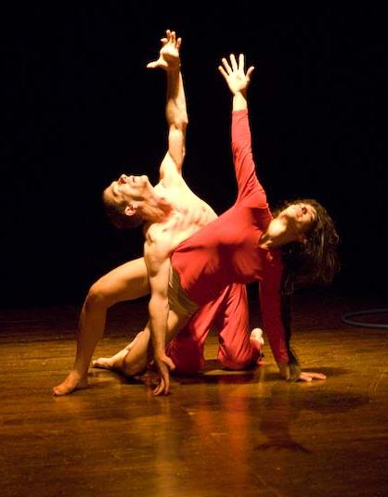
Methodology
Legal –Doctrinal
Qualitative
Arts- based – qualitative research that employs the premises, procedures, and principles of the arts (inter alia Given, 2008)
Dance
Participatory Film-making

Slide 6
Why Dance?
Dance emphasises embodiment and allows people with disabilities to express human diversity.
It is a form of art traditionally considered niche and allows to reflect on the intersection of different dimensions of cultural diversity
It is a powerful tool of non-verbal communication and can reach out to a wide audience

Slide 7
The first 6 months…
Research/Data Collection
Policy Contribution
Participation in 2 Consultation Processes
Academic Contribution
1 Article submitted
1 Article in preparation
Dissemination

Slide 8
Thank you for your attention!
e: delia.ferri@mu.ie
t: @DancingERC
https://ercdancing.maynoothuniversity.ie
This project has received funding from the European Research Council (ERC) under the European Union's Horizon 2020 Research and Innovation programme (grant agreement No. 864182).

