Slide 1
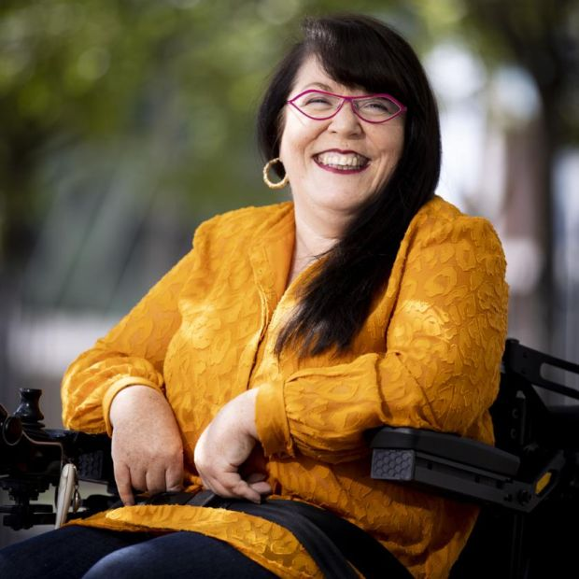
A conversation with Dr Rosaleen McDonagh author of Unsettled (Skein Press 2021)
The MU Sexualities and Genders Network and ERC Dancing Project are delighted to present, as part of Social Justice Week:
Tuesday 22nd March, 7 p.m. on Zoom
The event is free but please register on Eventbrite at: https://www.eventbrite.com/e/in-conversation-withdr-rosaleen-mcdonagh-tickets-291165352407
Dr McDonagh's widely acclaimed and ground-breaking book Unsettled offers a raw and uncompromising exploration of life from the perspective of a Traveller woman with a disability, exposing racism, ableism, and abuse while celebrating family and community. Author Anne Enright has described Unsettled as a book that "beats back the darkness, that "brings us all further on" and its author as "proud, smart and ingenious". Alongside being a board member of the Irish Human Rights and Equality Commission and of Pavee Point Traveller & Roma Centre, Dr McDonagh is an activist, playwright, author. We are delighted to share an evening conversation with her about her exceptional new book.
The DANCING project has received funding from the European Research Council (ERC) under the European Union's Horizon 2020 Research and Innovation programme (grant agreement No. 864182).​

