Slide 1
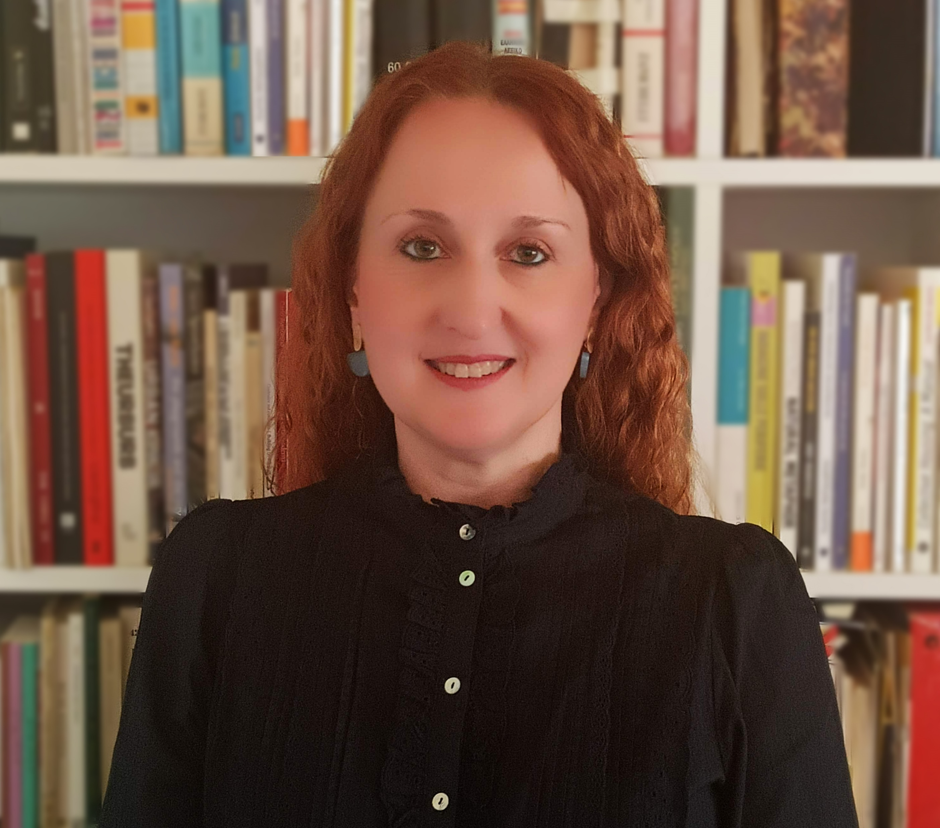
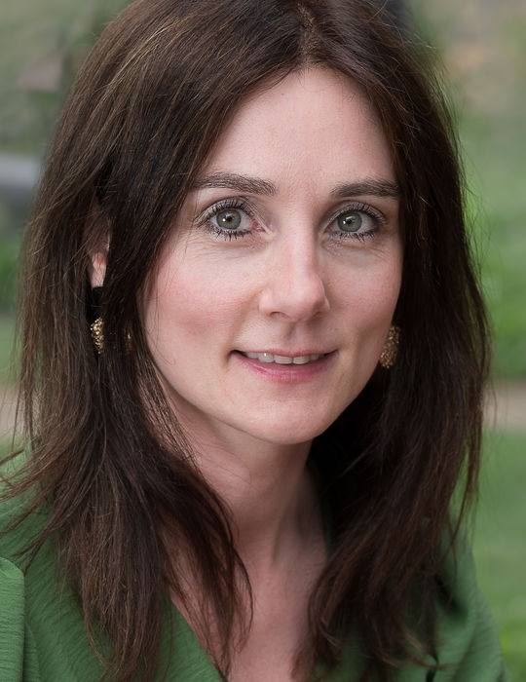
DANCING Academic Conversation
with
Dr. Evangelia Psychogiopoulou
(Assistant Professor, University of the Peloponnese)
and
Prof. Sarah Schoenmaekers
(Maastricht University)
Presenting their forthcoming co-edited volume:
European Union Economic Law and Culture: Towards a European Culturally Corrected Market Economy
Please register by sending an e-mail to:
eva.krolla@mu.ie
DATE: Thursday, 7 December
TIME: 13:00 – 14:00 (Dublin/GMT)
VENUE: Online (Teams)

