Slide 1

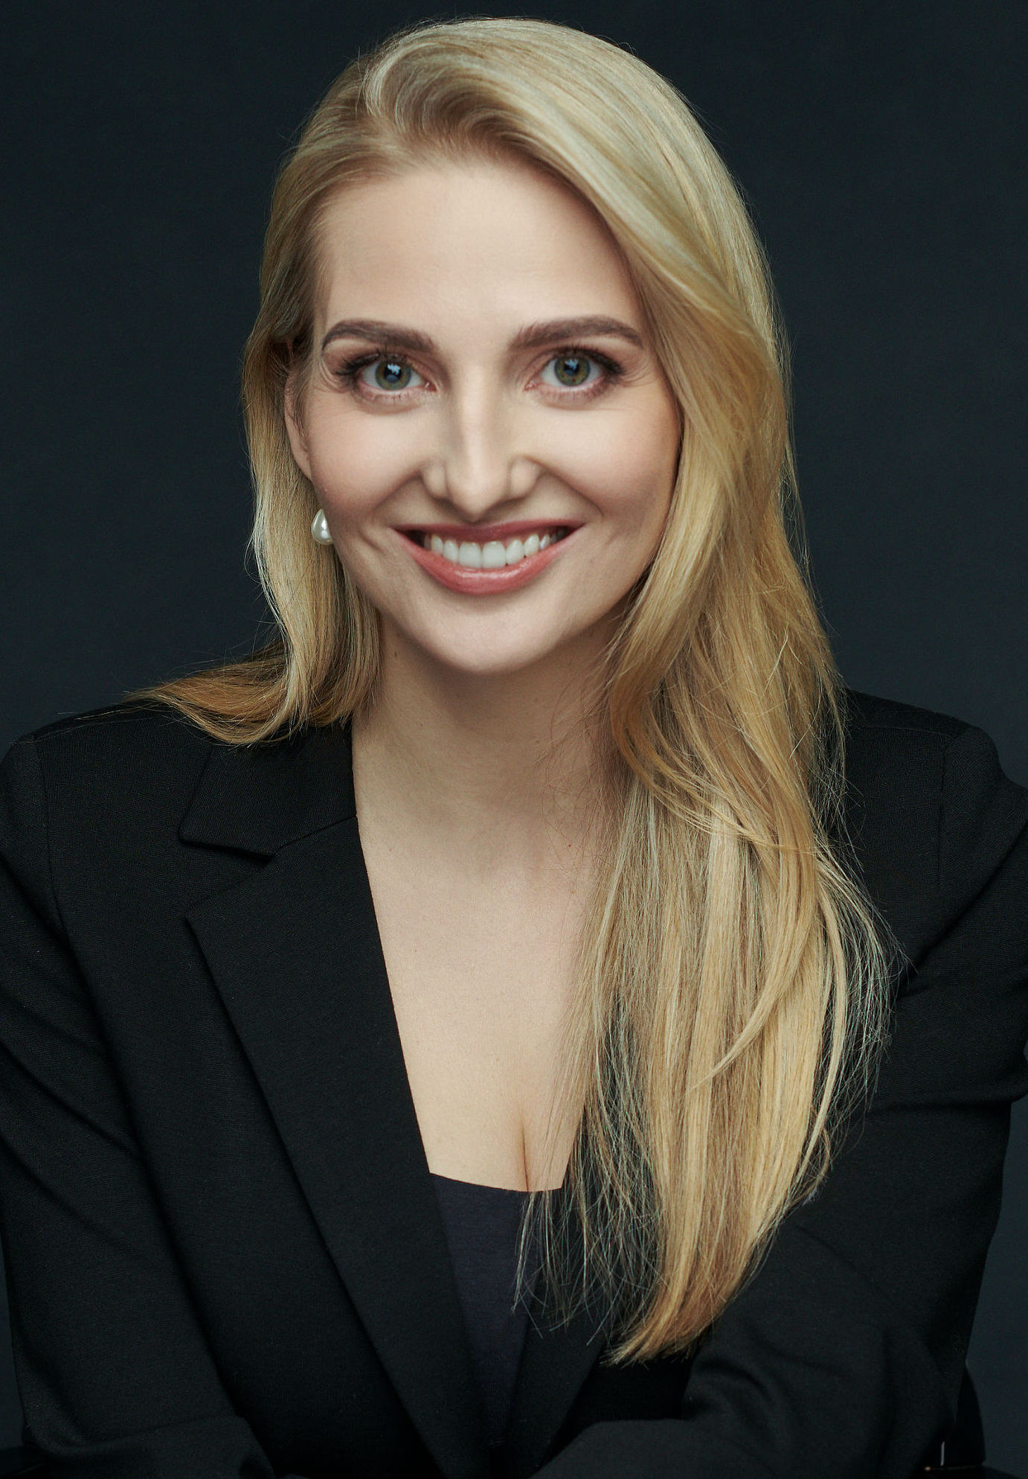





DANCING Academic Conversation
with
Dr. Vilija Vėlyvytė
Presenting her book:
Judicial Authority in EU Internal Market Law:
Implications for the Balance of Competences and Powers
(Hart Publishing 2022)
DATE: Friday, 9 February
TIME: 13:00 – 14:00 (GMT/Dublin)
VENUE: Online (Teams)
Please register by sending an e-mail to:
eva.krolla@mu.ie
This project has received funding from the European Research Council (ERC) under the European Union's Horizon 2020 Research and Innovation programme (grant agreement No. 864182).

