Slide 1
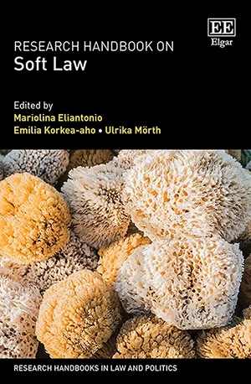
DANCING Academic Conversation
with
Prof. Mariolina Eliantonio, Prof. Emilia Korkea-aho and Prof. Ulrika Mӧrth
presenting their new book:
Research Handbook on Soft Law
(Edward Elgar 2023)
DATE: Thursday, 20 June
TIME: 12:00 – 14:00 (GMT/Dublin)
VENUE: Online (Teams)
Please register by sending an e-mail to:
eva.krolla@mu.ie
This project has received funding from the European Research Council (ERC) under the European Union's Horizon 2020 Research and Innovation programme (grant agreement No. 864182).

