Slide 1
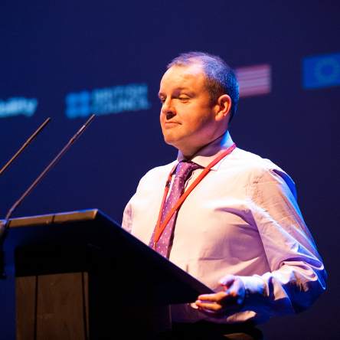
Audio Description: Legal Perspectives and Creative Practice Keynote Speaker: Pádraig Naughton (Arts & Disability Ireland) Discussant: Donal J Fitzpatrick (National Disability Authority) Roundtable facilitated by Dr. Emma Smith
Prof. Delia Ferri, PI of the ERC Project DANCING is delighted to present the seminar:
Date: Monday 21st November
Time: 12:00 – 13:30
Venue: MUSSI Seminar Room
3rd Floor, Iontas Building, North Campus, Maynooth University
Lunch and tea/ coffee will be served.
The DANCING project has received funding from the European Research Council (ERC) under the European Union's Horizon 2020 Research and Innovation programme (grant agreement No. 864182).​
Please register by sending an e-mail to: eva.krolla@mu.ie

